Slide 1
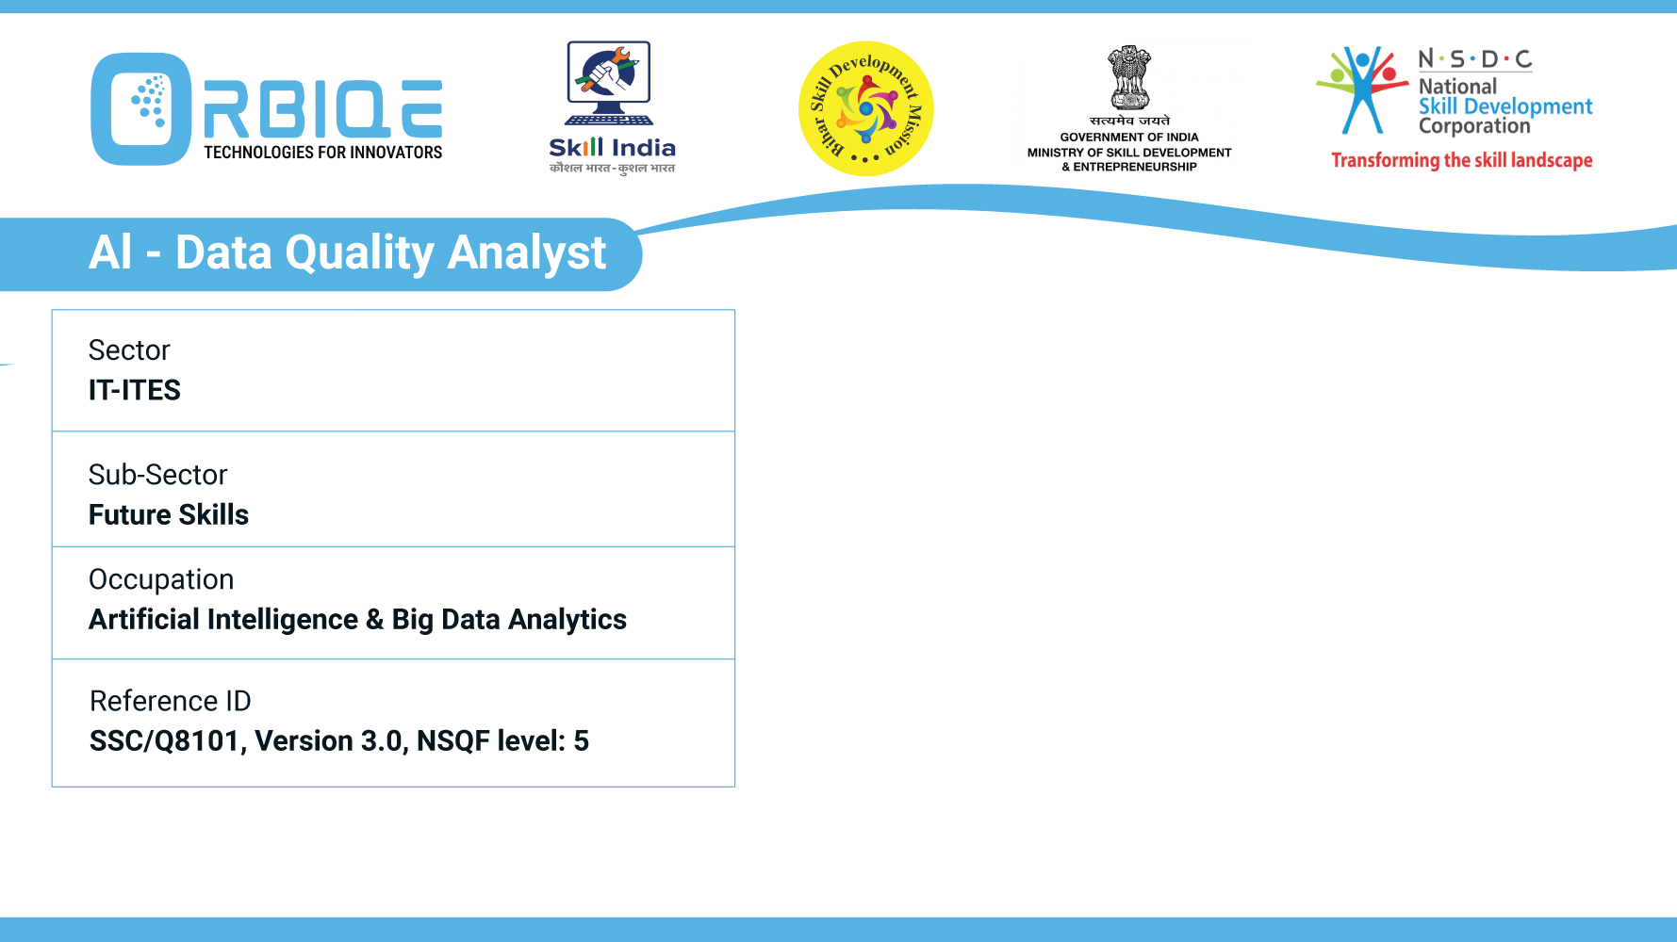
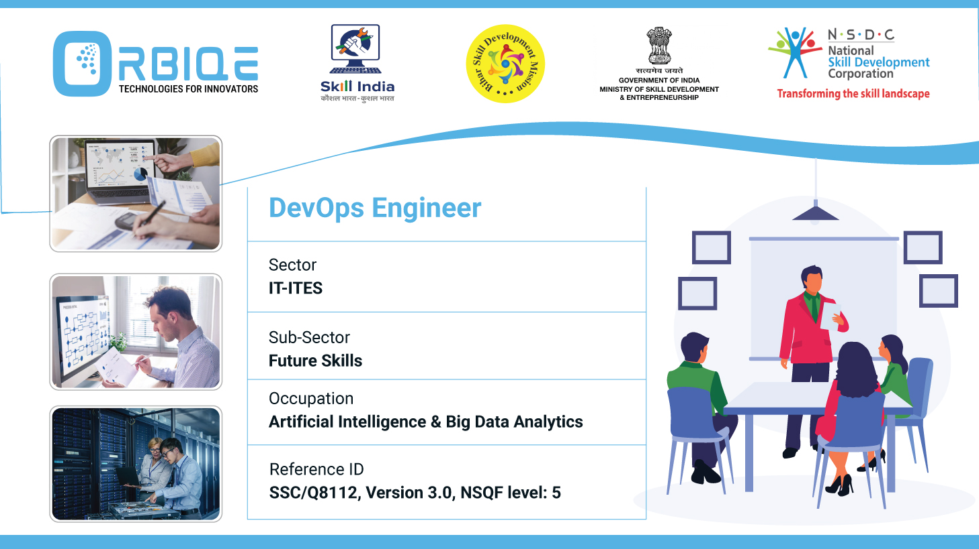
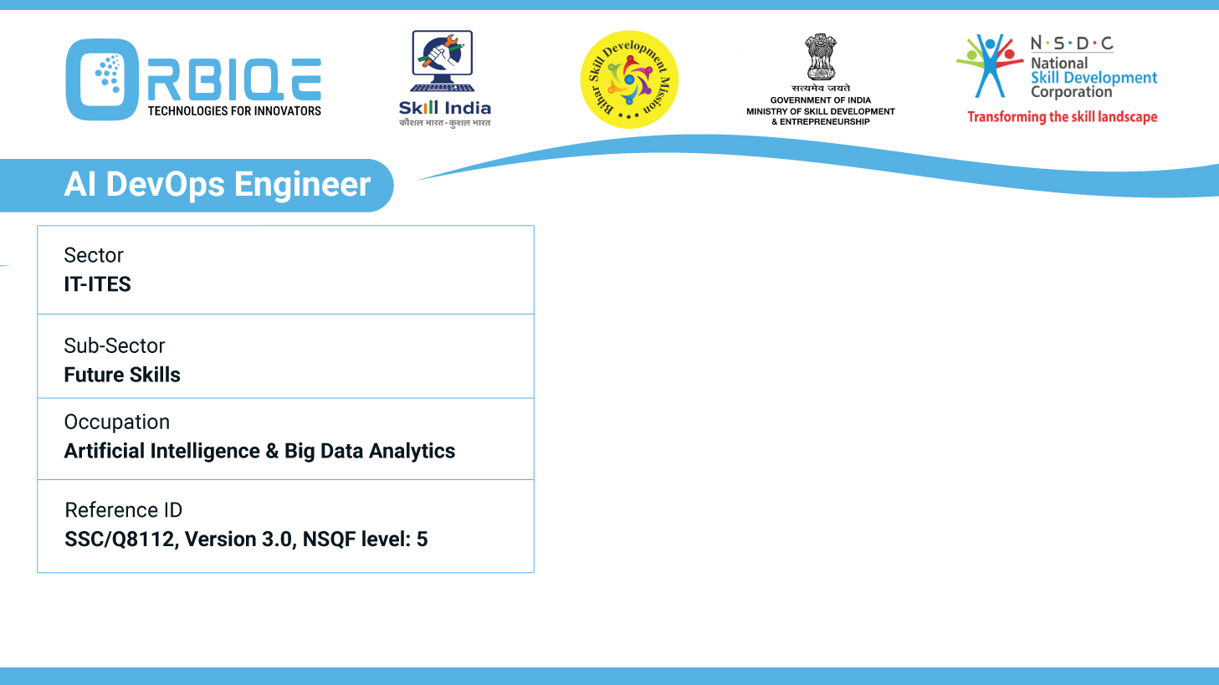
Name- Krishna Kant Dubey

Slide 2

Data Validation

Slide 3
Agenda
Describe the purpose of metadata
Describe various Data validation tools and processes

Slide 4
Metadata
What Is Metadata?
Purpose of Metadata
Types of Metadata

Slide 5
What Is Metadata?
Metadata refers to descriptive information that provides context about a data asset—such as its origin, structure, meaning, and usage.

Slide 6
Purpose of Metadata
Data Discovery
Helps users find relevant datasets by describing content, keywords, and categories.
Enables searchability in data catalogs and repositories.
Data Understanding
Explains what each field means, its format, units, and relationships.
Clarifies how data was collected, transformed, and validated

Slide 7
Purpose of Metadata
Data Governance & Compliance
Tracks ownership, access rights, and regulatory constraints (e.g., GDPR tags).
Supports audit trails and lineage tracking.
Data Quality & Integrity
Includes timestamps, versioning, and validation rules.
Helps detect anomalies, duplicates, or outdated records.

Slide 8
Purpose of Metadata
Interoperability
Standardized metadata enables integration across systems, APIs, and platforms.
Facilitates schema mapping and ETL processes.
Automation & AI
AI systems use metadata to understand context, apply correct models, and automate workflows.
Enables intelligent indexing, tagging, and recommendation systems.

Slide 9
Types of Metadata
Type | Description | Example
Descriptive | What the data is about | Title, author, keywords
Structural | How the data is organized | Table schema, file format
Administrative | Who owns it, how it’s managed | Access rights, creation date
Statistical | Summary metrics and distributions | Mean, standard deviation
Provenance | Where the data came from | Source system, transformation steps

Slide 10
Popular Data Validation Tools
Tool Name | Description | Best For
Great Expectations | Open-source tool for defining, testing, and documenting data expectations | Python-based pipelines, ETL
Deequ (by AWS) | Library for defining "unit tests" for data quality in Spark | Big data validation in Spark
Cerberus | Lightweight Python schema validator | JSON and Python dict validation
Voluptuous | Python library for validating data structures | Config files, API payloads
Atlan | Data governance platform with built-in validation workflows | Enterprise data catalogs
Talend Data Quality | GUI-based tool for profiling, cleansing, and validating data | ETL and business intelligence
DataCleaner | Java-based tool for profiling and validating structured data | Batch validation and cleansing
OpenRefine | Tool for cleaning and transforming messy data | CSV/Excel cleanup and validation

Slide 11
Key Data Validation Process
Schema Validation
Ensures data conforms to expected structure: field names, types, constraints.
Example: customer_id must be an integer, email must be a string.
Format & Type Checks
Verifies that values match expected formats (e.g., dates as YYYY-MM-DD, phone numbers).
Prevents malformed entries from breaking downstream logic.

Slide 12
Key Data Validation Process
Range & Constraint Checks
Ensures values fall within acceptable ranges.
Example: Age must be between 0 and 120.
Uniqueness & Duplication Checks
Detects duplicate records or ensures unique keys (e.g., email, ID).

Slide 13
Key Data Validation Process
Cross-field Validation
Validates relationships between fields.
Example: start_date must be before end_date.
Reference Integrity
Ensures foreign keys match existing records in related tables.
Real-time vs Batch Validation
Real-time: Validates data at entry (e.g., form submission).
Batch: Validates large datasets during ETL or migration.

Slide 14
Automation Strategies
Python Libraries: Use pydantic, voluptuous, or cerberus for API and form validation.
ETL Pipelines: Integrate validation steps using tools like Talend or Great Expectations.
Cloud Services: AWS Glue and Azure Data Factory support
rule-based validation.
CI/CD Integration: Run validation tests during deployment to catch schema drift or data anomalies.

Slide 15
Thank You

